Slide 1
Effective Python coding examples
Hanlin Xiao

Slide 2
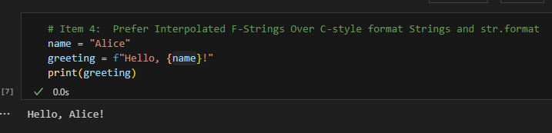
Item 4: Prefer Interpolated F-Strings Over C-style Format Strings and str.format
Purpose: Provides a more readable, concise, and less error-prone way of formatting strings.
Implementation: Use f-strings, denoted by f'', which directly incorporate expressions inside string literals.
Example: Instead of older formatting methods, use f-strings for straightforward string interpolations, as shown in the greeting example.

Slide 3
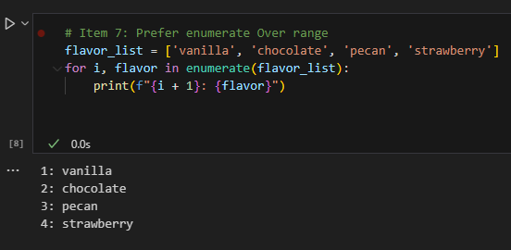
Item 7: Prefer enumerate Over range
Purpose: Enhances clarity and conciseness when iterating over a sequence and you need to track the index of elements.
Example: When printing each flavor in a list with its corresponding index, enumerate makes it straightforward and readable by providing both index and value in the loop.

Slide 4
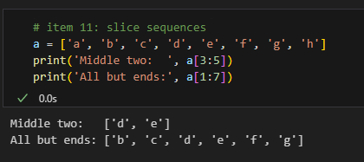
Item 11: Slice Sequences
Purpose: Effective way to access sub-parts of sequences like lists or strings.
Example: Accessing the middle two elements or all elements except the ends of a list.

Slide 5
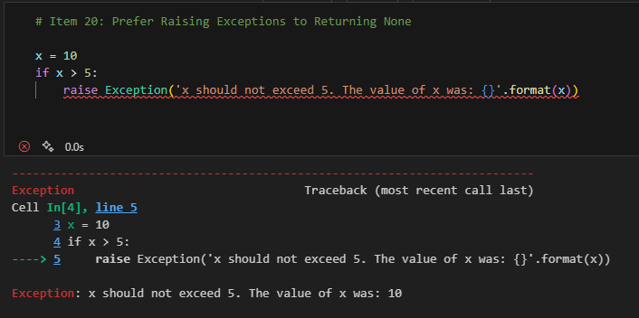
Item 20: Prefer Raising Exceptions to Returning None
Purpose: Helps in avoiding silent failures in the code.
Example: When x exceeds 5, an exception is raised to alert that x should not be greater than 5, providing immediate feedback about the error.

Slide 6
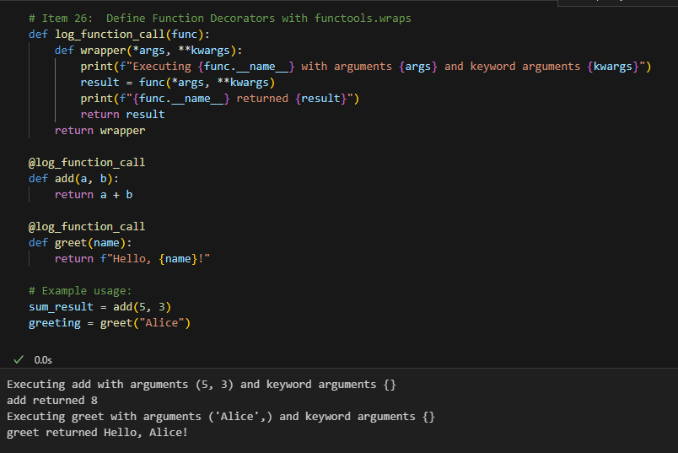
Item 26: Define Function Decorators with functools.wraps
Purpose: Ensures that when decorating a function, the decorated function maintains its metadata.
Example: The log_function_call decorator adds logging before and after a function call without changing the function’s metadata.

